Slide 1

Mid-Project Reviews
Indoor Drone
Group 9

Slide 2
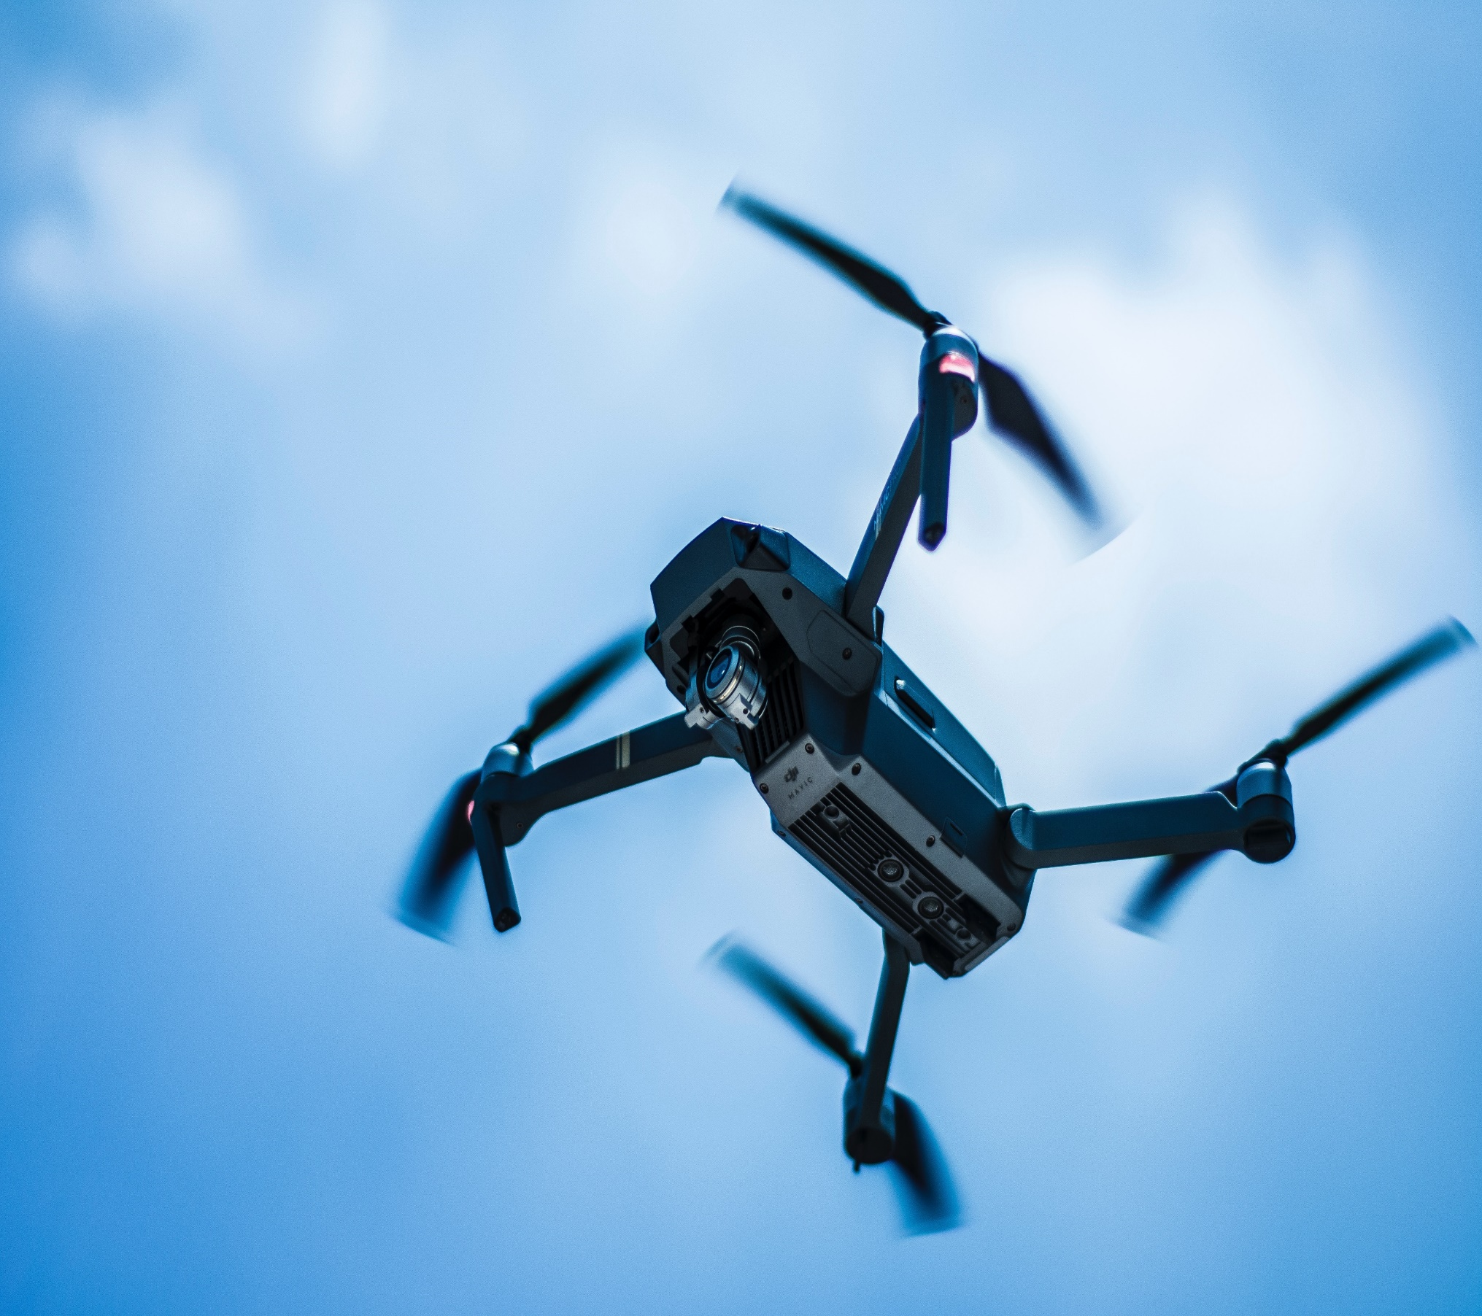

Project Stages
Progress
Finish soldering electrical parts
Created a simulated environment
Basic function commands
Assembled Drone components
Unit testing

Slide 3

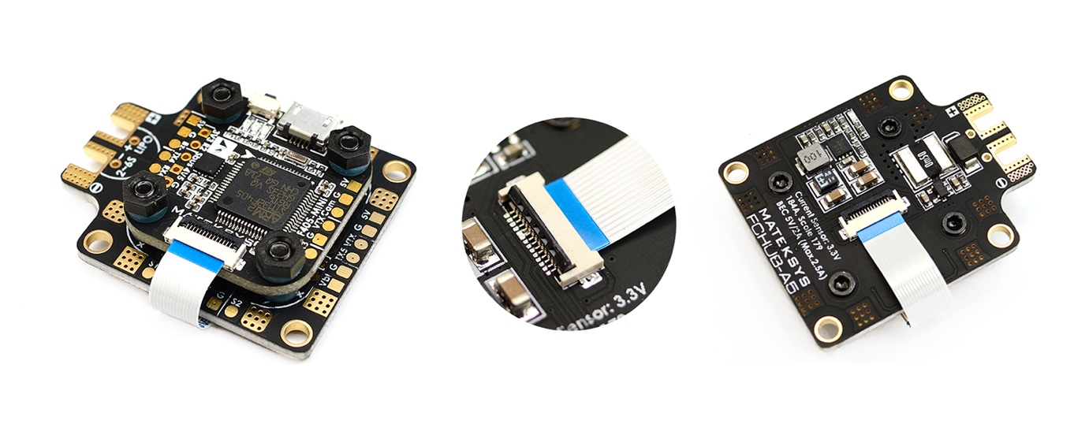
Drone version 1
Matek F405-mini
Pros
Widely used.
Firmware is supported with Betaflight (open source platform)
Can connect with camera for further usages
Having video transmitter feature
Small and light, suitable for small drone
Cons
It is hard to access the firmware to adjust the code inside and debug
Because this type of board usually using for racing or entertainment purpose, we could not find any support resources. So, it is hard for us to modify the FC.
It is small so it’s very difficult for us soldering things together
Not supported for stage 2 (autopilot controlling)

Slide 4
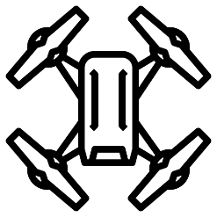
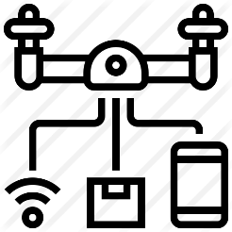
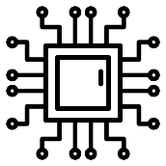
Drone version 2
Drone v1.0
With what we’ve learned and available resources
Automated
Support customization and better automation capability
Semi-automated
Drone
New flight controller
A new controller that fits our requirements

Slide 5

ARDUINO
controller
Pros
Low cost
On board storage
Cons
Require external hardware to connect to the internet
Only one USB port to connect to computer
Low memory prone to froze when executing codes
Arduino is only suitable for performing repetitive, simple tasks.

Slide 6
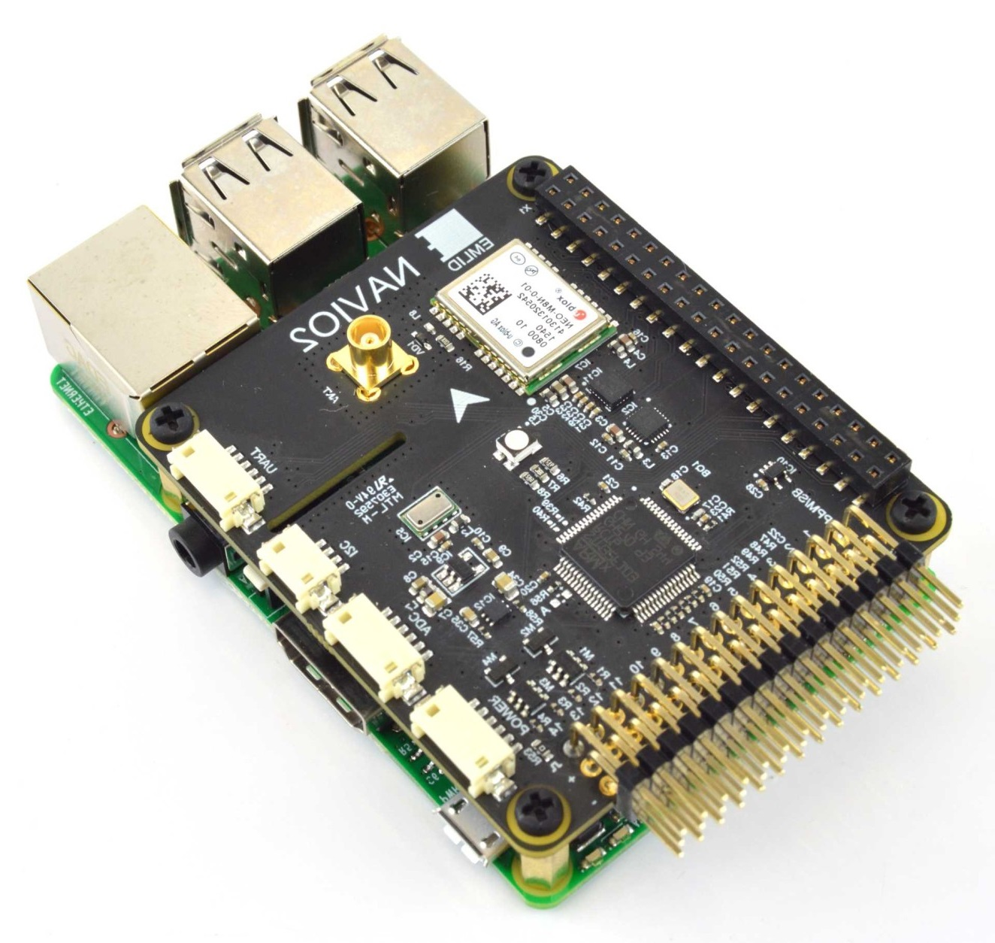
NAVIO2 flight controller + Raspberry pi model 3B
PROS
RPi
Raspberry Pi is a general-purpose computer
More suitable to control complicated machine like robots
Capable of doing intense calculations
Capable of performing multiple complicated tasks
Wi-Fi capable
NAVIO2
Run on Linux environment
Easy to setup and interact with
Can SSH into your drone while its flying
Can update firmware wirelessly ( with Wi-Fi )

Slide 7
NAVIO2 flight controller + Raspberry pi model 3B
CONS
Expensive
Difficult to power using battery pack
Require SD card for storage
Risk of files corruption and software problems
RPi
NAVIO2
Is not optimize for real time application
May experience hiccup when run resource heavy scripts
Very new and not widely seen in industrial applications

Slide 8
Decision made
Changes
Platform
Stages
Stages
Frame
Arduino
New platform
Connection method
GPS tracking
F450 frame
Change from using Arduino as alternative plan to Raspberry pi + Navio 2
Using Ardupilot and Dronekit as platform to support coding to control the drone through a companion computer
First phrase will be control the drone by using ssh
Using Nogps to guide the drone flight to a direction, an alternative ways instead of using GPS
Transfer drone component to smaller frame after finished drone v2
Raspberry pi + Navio 2
Ardupilot + Dronekit
SSH
nonGPS navigation
Smaller frame

Slide 9
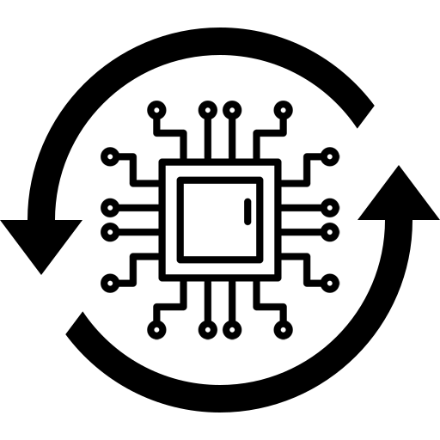




Hardware challenges
Get a modern PowerPoint Presentation that is beautifully designed. I hope and I believe that this Template will your Time.
Pre-arm check
Repurpose firmware
Configuring the settings of Pre-arm Safety Checks in Mission Planner (a ground control station for Plane, Copter and Rover)
Some parameters, stored in ardupilot-raspberry, are not suitable when working with indoor-environment.
Failsafe triggers
Manual flight mode
The pre-arm check and the imported parameters does not fit and triggers failsafe error
Drone does not arm even if we change the manual flight modes that do not require GPS for the purpose of indoor flight
Problem by problem
We are still working to solve this problem by searching this error, trying to adjust the value of parameters relating to Pre-arm Safety Checks

Slide 10




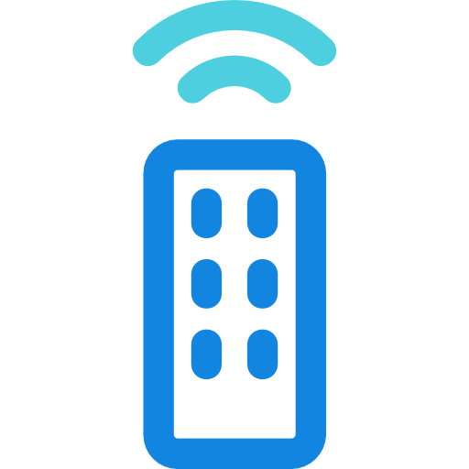
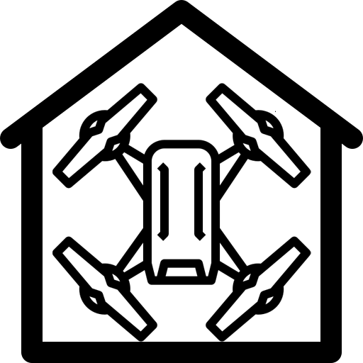

Autonomous status
ArduPilot
Ardupilot is open source autopilot software
Dronekit
API allows developers to create Python apps that communicate with vehicles over MAVLink
ArduPilot
Capable of controlling almost any vehicle system imaginable
Dronekit
A best solution to our indoor copter that uses onboard companion computers with the addition of open source library
ArduPilot
Has advanced data-logging, analysis and simulation tools.

Slide 11
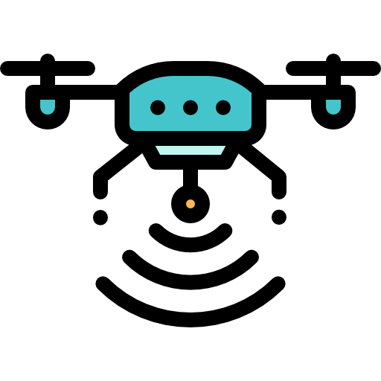
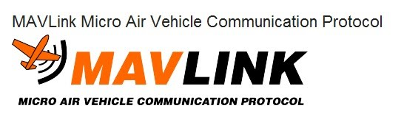


Drone diagram

Slide 12



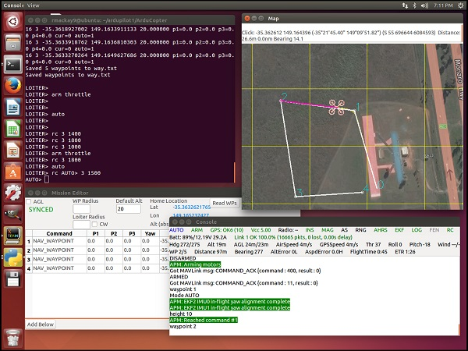
SITL simulator
(Software in the loop)
The SITL (software in the loop) simulator allows you to run Plane, Copter or Rover without any hardware. It is a build of the autopilot code using an ordinary C++ compiler, giving you a native executable that allows you to test the behavior of the code without hardware.
Directly on your computer
Without any special hardware
Simulated data

Slide 13
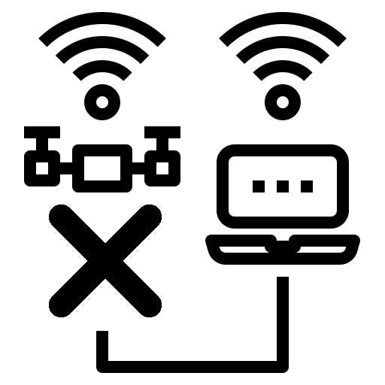



Software challenges
Communication
Flight mode
Navigation
Communication
Connection between drone and station
Guided mode flight code
nonGPS navigation
Script integration
Connection code between drone and ground control station is still unstable. Vary between computers and network state
Bug happens when we try to use guided flight mode script
nonGPS flight script is still in researching
Bugs and errors when implementing scripts onto drone

Slide 14
Team member contribution
Hoan (Hardware)
Drone version 2:
Research compatible drone-hardware
Find suitable ground control
Assemble drone parts (Raspberry Pi, Navio2, ESC…) to drone frame
Solder ESCs and drone power distribution board to test motor
Install raspbian and ardupilot firmware to RPi
Configure ardupilot in RPi
SSH to RPi via wifi
Install mission planner (ground control station) on laptop and configure/connect to RPi on drone
Test ground connection with hardware
Calibrate ESC and compass of drone with mission planner
Adjust parameters of ardupilot in Rpi to let the drone arm
Drone Version 1:
Research frames and drone schematics
Research components (propeller, ESC, FC, PDB, motor, battery)
Solder drone parts:
Solder wires to drone controller (FC)
Solder ESC to FC
Install firmware to drone controller
Install Flight controller software(Beta-flight) to laptop
Connect flight controller to laptop and configure drone settings
Adjust radio control signals
Test motors and RX signals (receiver)
Test indoor flight

Slide 15
Team member contribution
Thịnh (Hardware)
Drone Version 1:
Research frames and drone schematics
Research components (propeller, ESC, FC, PDB, motor, battery)
Assemble drone components:
Attach components to the frame
Attach propeller with motors
Install firmware to drone controller:
Install Flight controller software(Beta-flight) to laptop
Connect flight controller to laptop and configure drone settings
Calibrate ESCs and propellers
Test motors and RX signals (receiver)
Drone version 2:
Research compatible drone-hardware
Assemble drone parts (Raspberry Pi (Ppi), Navio2, ESC…) to drone frame
Solder ESCs and drone power distribution board to test motor
Install raspbian and ardupilot firmware to Rpi
Configure ardupilot in Rpi
SSH to Rpi via wifi
Install mission planner (ground control station) on laptop and configure/connect to Rpi on drone
Test ground connection with hardware
Calibrate ESC and compass of drone with mission planner

Slide 16
Team member contribution
Huy (Software)
Research compatible platform (software)
Configuration detecting plugin fly control board for betaflight
Drone component research
Research on drone frame and model
Buying drone component
Config Matek f405mini firmware from betaflight
Basic drone movement script (take-off, landing, configuration, velocity setting)
Simple go-to script (Flight forward)
nonGPS navigating solutions (Manually import flight path)
Guided flight script (drone take-off, move forward and landing without using GPS)

Slide 17
Team member contribution
Y (Software)
Research compatible platform (software)
Configuration flashing port to connect the board
Drone component research
Research on drone frame and model
Fixing Transmitter can’t activate armed mode to control
Establish component into drone frame
Set up simulated environment
Parameter configuration
Basic drone movement script (connection)
Connecting APM planner to script to simulate script
Establish connection between companion computer to raspberry pi

Slide 18
Team member contribution
Quan (Tester)
Test run simulator
Start SITL (Software in the Loop) drone
Documentation
Hardware compatibility test
Config Drone version 1
Fix calibrations
Fix telemetry connection

Slide 19



Future plan
Solve hardware problems
Establish connection between companion computer with copter
Apply mission plan into copter
Optical-flow research to increase safety while flying

Slide 20
Thank you

